Slide 1

Lesson 4 - Human activity Recognition and valve examples
Luis Miralles

Slide 2
Identifying the state of a valve from sensors reading using machine learning methods

Slide 3
Abstract
Company X works with platforms to extract in the Oil and Gas sector.
Predictive maintenance models attempt to identify developing issues with industrial equipment before they become critical.
The supervised approach is appropriate for valves with a long operation history and requires manual state assessments.
The unsupervised approach is suitable for addressing the cold start problem when new valves with no operational history come online.

Slide 4
Supervised learning approach

Slide 5
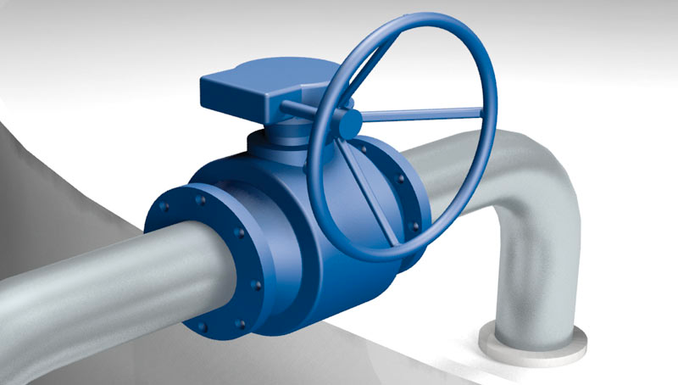
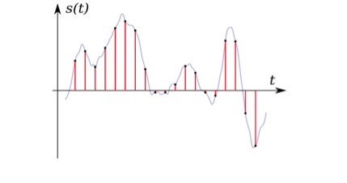
ML for Valve Health Identification
Three sensors (S1, S2, S3) capture the evolution of the valve for each event.
Sensors 1 and 3 measure pressure, and sensor 2 cumulative volume.
The state of a valve has three possible values: Healthy, Degrading, and Failure.
Automatic Valve Health Identification for the Maintenance of Subsea Industrial Equipment.
The dataset has 6648 readings and 360 (=3x120) points.
We merged the Degrading and Failure into a class called Unhealthy.

Slide 6
Signal features in time and frequency domain
Time domain features
Frequency domain features (After applying FFT)
Standard Deviation Max Value Min Value Mean of all values Absolute mean of all values Max index of all values Min index of all values Root Mean Square Absolute Variance Absolute (max/min) Absolute Median Zero crossing Skewness Kurtosis Third percentile Interquartile Correlation | Absolute mean Absolute median Root Mean Square Entropy Shannon Entropy Flatness Mode Peak Frequency

Slide 7
*Derived means using extracted features in time and frequency.
Benchmark of the top 10 Models predicting two classes leaving 15 valves out
N | Data | Leave N Out | CutOff | Model | Auc | Acc | Sens | Spec | Prec | F1 | TP | FP | FN | TN | Total | Time
1 | Derived | 15 | 0.5 | AdaBoost | 0.9900 | 0.9816 | 0.7123 | 0.9974 | 0.942 | 0.8112 | 260 | 16 | 105 | 6191 | 6572 | 86.63
2 | Derived | 15 | 0.5 | Rand Fst | 0.9887 | 0.9822 | 0.726 | 0.9973 | 0.9397 | 0.8191 | 265 | 17 | 100 | 6190 | 6572 | 7.64
3 | Derived | 15 | 0.5 | DL Gbm | 0.9881 | 0.9799 | 0.6822 | 0.9974 | 0.9396 | 0.7905 | 249 | 16 | 116 | 6191 | 6572 | 81.24
4 | Derived | 15 | 0.5 | C5 | 0.9841 | 0.9776 | 0.6575 | 0.9965 | 0.916 | 0.7655 | 240 | 22 | 125 | 6185 | 6572 | 17.31
5 | Combined | 15 | 0.5 | Rand Fst | 0.9823 | 0.974 | 0.5863 | 0.9968 | 0.9145 | 0.7145 | 214 | 20 | 151 | 6187 | 6572 | 73.54
6 | Combined | 15 | 0.5 | C5 | 0.9819 | 0.9778 | 0.6548 | 0.9968 | 0.9228 | 0.766 | 239 | 20 | 126 | 6187 | 6572 | 236.08
7 | Combined | 15 | 0.5 | DL Gbm | 0.9806 | 0.9799 | 0.6822 | 0.9974 | 0.9396 | 0.7905 | 249 | 16 | 116 | 6191 | 6572 | 474.31
8 | Combined | 15 | 0.5 | AdaBoost | 0.9805 | 0.981 | 0.7068 | 0.9971 | 0.9348 | 0.805 | 258 | 18 | 107 | 6189 | 6572 | 940.63
9 | Raw | 15 | 0.5 | Rand Fst | 0.9779 | 0.9725 | 0.5699 | 0.9961 | 0.8966 | 0.6969 | 208 | 24 | 157 | 6183 | 6572 | 58.67
10 | Raw | 15 | 0.5 | DL Gbm | 0.977 | 0.9781 | 0.6959 | 0.9947 | 0.885 | 0.7791 | 254 | 33 | 111 | 6174 | 6572 | 516.4

Slide 8
Reducing the number of false negatives
False positive: The model says there is a condition that it does not have. Example: The model says that the valve is unhealthy, but it is healthy.
False negative: Just the opposite case. The model says the valve is healthy, but it is unhealthy.
Solution: We must reduce the sensitivity without increasing the specificity too much.

Slide 9
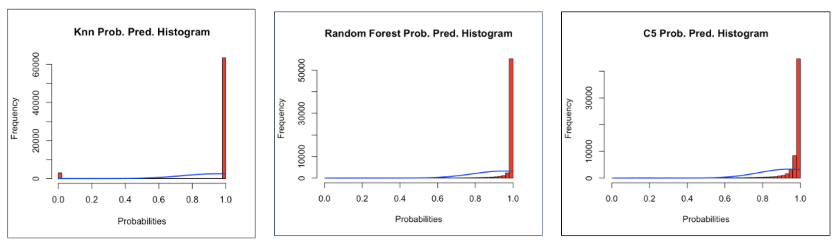
Spectrum Probability Comparison
KNN vs Random Forest vs C5
The probability distribution of the 66,480 predictions tends to favour the range [0.98,1.0] and does not spread well. Thus, we made another experiment with AdaBoost.

Slide 10
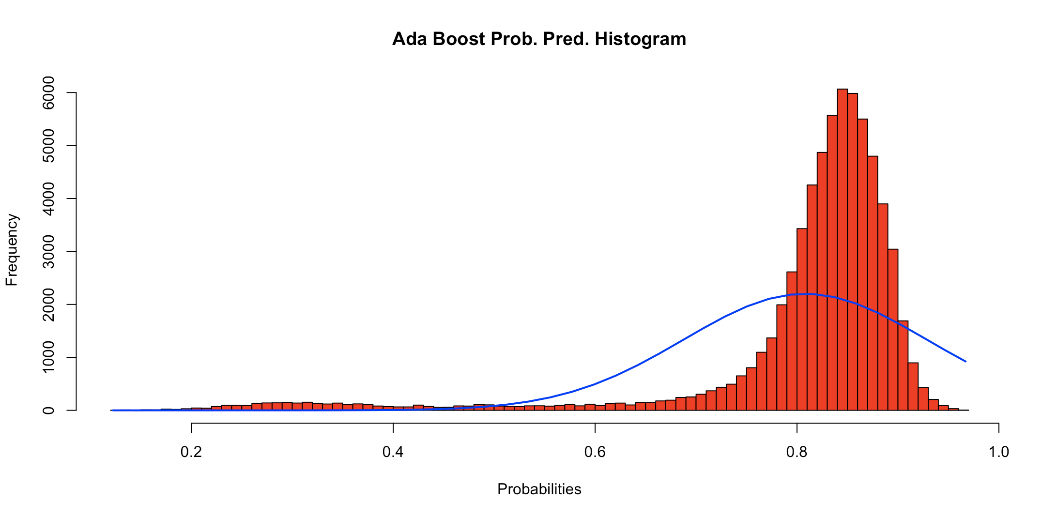
AdaBoost Spectrum Probability Comparison
Original value
= 0.5
New value = 0.75
AdaBoost seems much better values are more distributed along the X-axis. Spread is observed around 0.8 value.

Slide 11
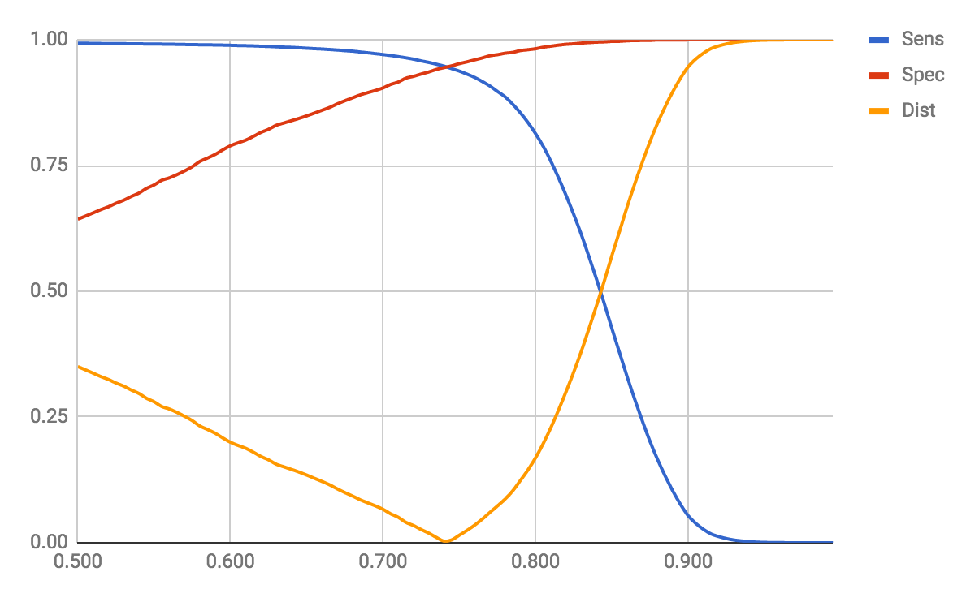
Summary of tuning cut-off parameter using AdaBoost
= abs(Sens-Spec)
Cut-off: 0.740
1
Healthy
Unhealthy
Threshold : 0.740
0
Criteria: Selecting Minimum Distance. Where distance is calculated as Dist = abs(Sens-Spec).

Slide 12
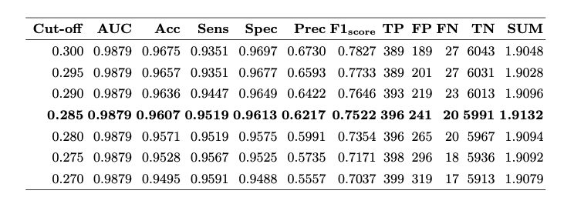
Best cut-off parameter for AdaBoost leaving 15 valves out
*SUM represents the summation of sensitivity and specificity.

Slide 13
AdaBoost Probability: Using a new cut-off value
Sensitivity From 58% to 94.47% and Specificity from 99.56% to 94.47%
Data type | Leave N Out | CutOff | Dist | Model | Auc | Acc | AvgAcc | Sens | Spec | Prec | F1 | TP | FP | FN | TN | TOTAL | TIME
Derived | 100 | 0.74 | 0.003 | AdaBoost | 0.9836 | 0.9475 | 0.9462 | 0.9477 | 0.9447 | 0.9961 | 0.9713 | 59061 | 230 | 3259 | 3930 | 66480 | 117.54
Derived | 100 | 0.925 | 0.0008 | RandFst | 0.9843 | 0.9495 | 0.9492 | 0.9496 | 0.9488 | 0.9964 | 0.9724 | 59179 | 213 | 3141 | 3947 | 66480 | 4.73
Threshold : 0.74
Prediction
Threshold : 0.925
Prediction
 | UnHealthy | Healthy
UnHealthy | 3930 | 230
Healthy | 3259 | 59061
 | UnHealthy | Healthy
UnHealthy | 3947 | 213
Healthy | 3141 | 59179
Actual
Actual
Ada Boost
Random Forest
False negatives

Slide 14
Unsupervised learning approach

Slide 15
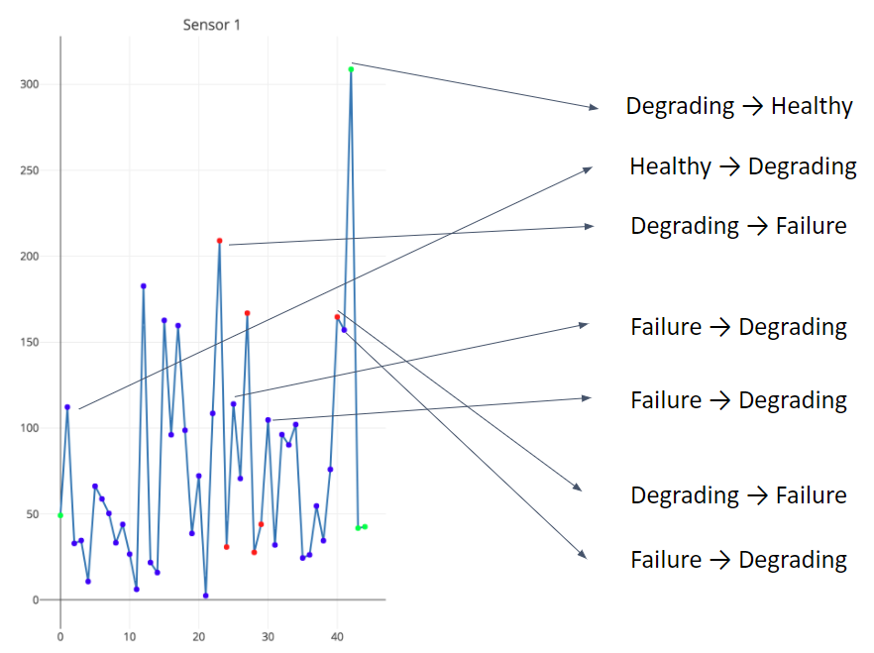
What is it an anomaly?

Slide 16
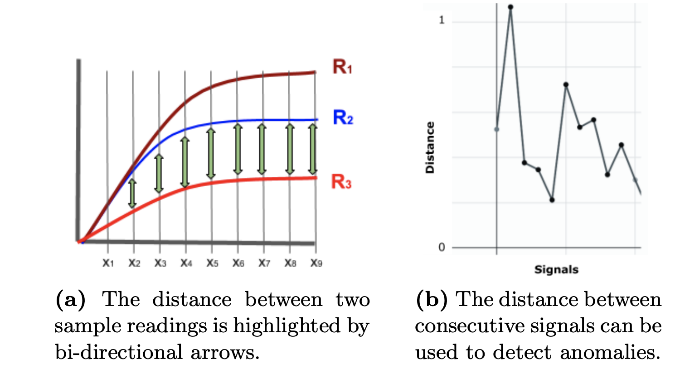
Usage of distance metric as an anomaly detector

Slide 17
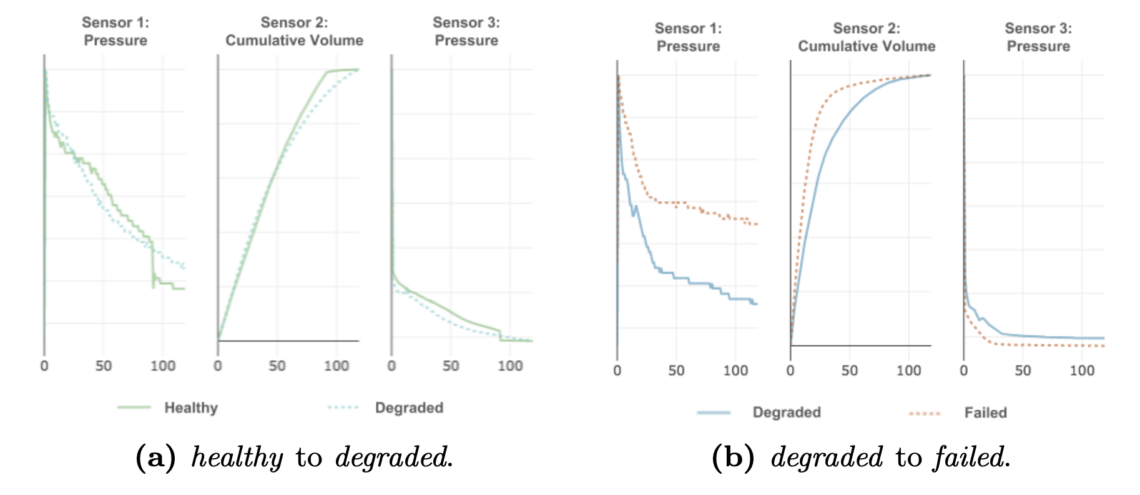
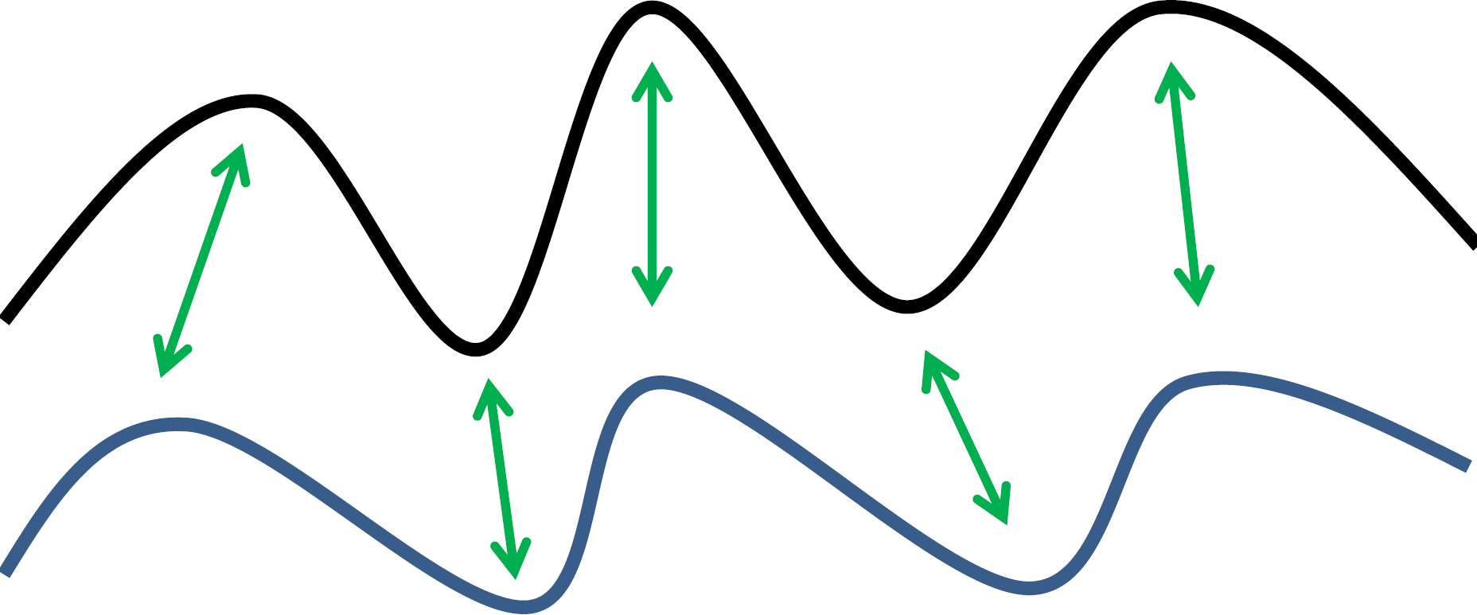
Anomaly detection using distance metrics
Euclidean
Dynamic Time Warping
SAX
Levenshtein
Canberra
Hausdorff
Manhattan
Bray-Curtis
Minkowski
Discrete Frechet
Chebyshev
Jaccard
1 - Cosine
Spearman
Correlation

Slide 18
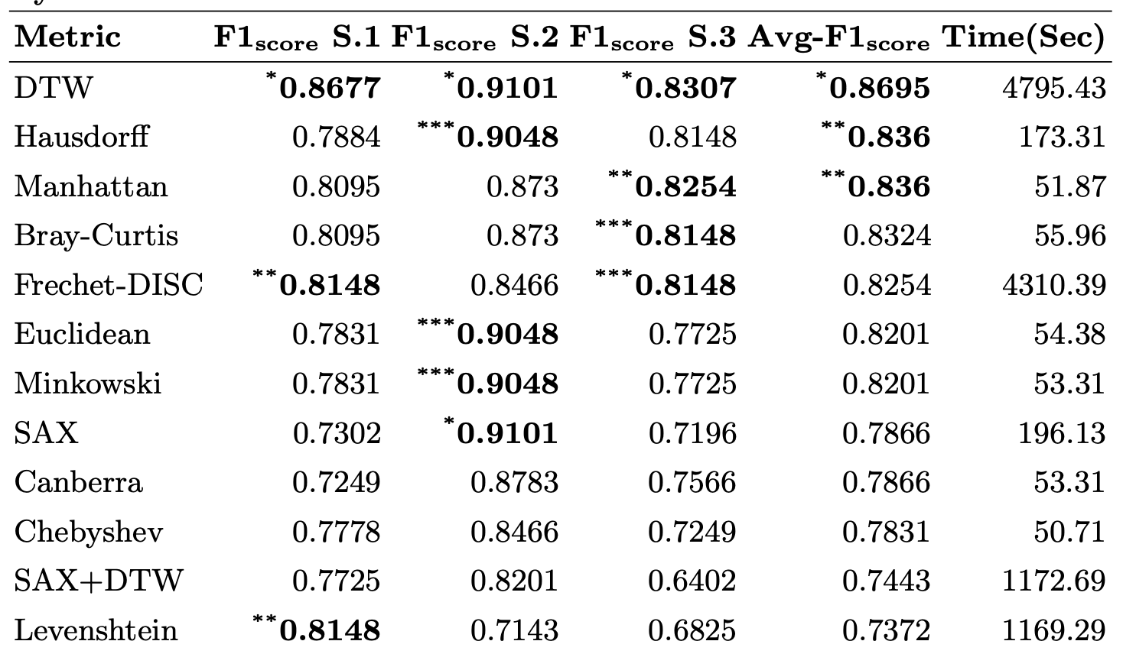
Evaluation of the suitability of different distance metrics
Performance of distance metric using the raw sensor.
We performed a simple experiment in which we trained 1-Knn classifiers with 201 samples and tested them with 188.
We perform these experiments independently and using F1 scores. The *, **, and *** show the top one, two, and three ranked F1 Scores in the column, respectively.
Bray-Curtis is at least 77 times faster compared to Frechet-DISC and DTW
We can see that DTW outperforms all other distance metrics, however, this is at the expense of significant running time. For use as the basis of an anomaly detector, for each sensor and the average we selected the 3 best performing distance measures. These are: DTW, Frechet-DISC, Levenshtein, SAX, Hausdorff, Euclidean, Minkowski, Manhattan, and Bray-Curtis.

Slide 19
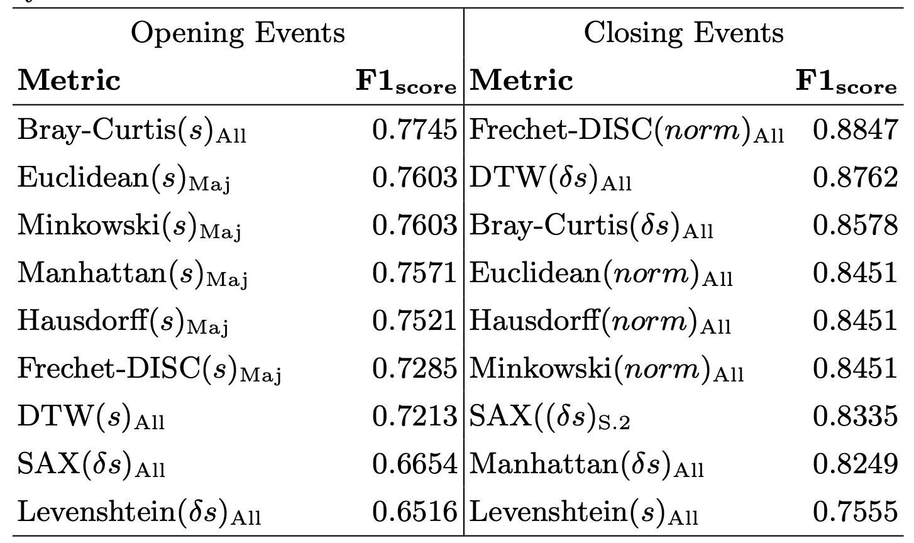
Anomalies: When comparing the last signals using a threshold
The performance of anomaly detectors is based on different distance metrics for valve opening and closing events when comparing the distance between the last two signals.
(s), (δs), and (norm) indicate that the named measure was applied to the original signal, the derivative of the original signal, or the normalised signal, respectively.
The subscripts All, Maj, and S.x indicate that the anomaly detection decisions were made using all sensor agreement voting, majority voting, or only with sensor x, respectively.
The table shows the best signal and sensor voting strategy combination for each distance measure. It shows a reasonably good ability to recognise anomalies using several distance measures.

Slide 20
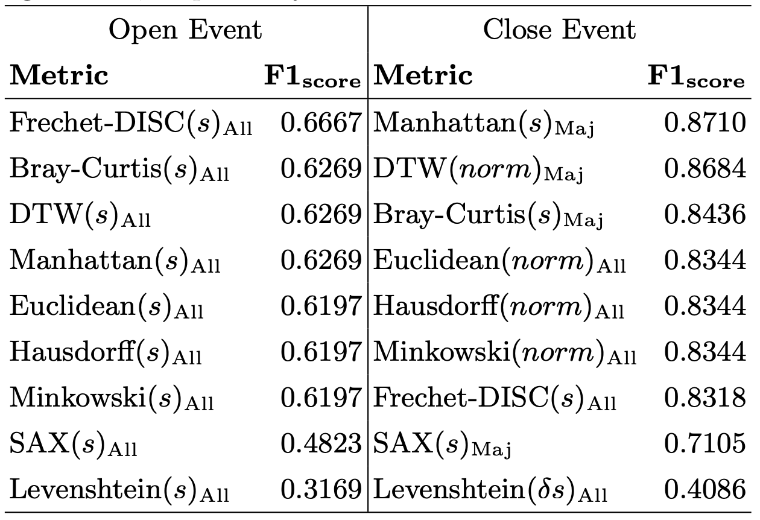
Anomalies: When comparing the average last three signals using a threshold
The performance of distance metrics as an anomaly detector for the valve's open and close events when comparing the distance between the average of the last three signals and the most recent signal.
Where (s) and (norm) show the original and normalised signals, respectively.
The subscripts All and Maj show all sensor agreement and majority agreement, respectively
The table shows the performance of the anomaly detectors based on the average of the preceding three signals (avgstep-3) approach.

Slide 21
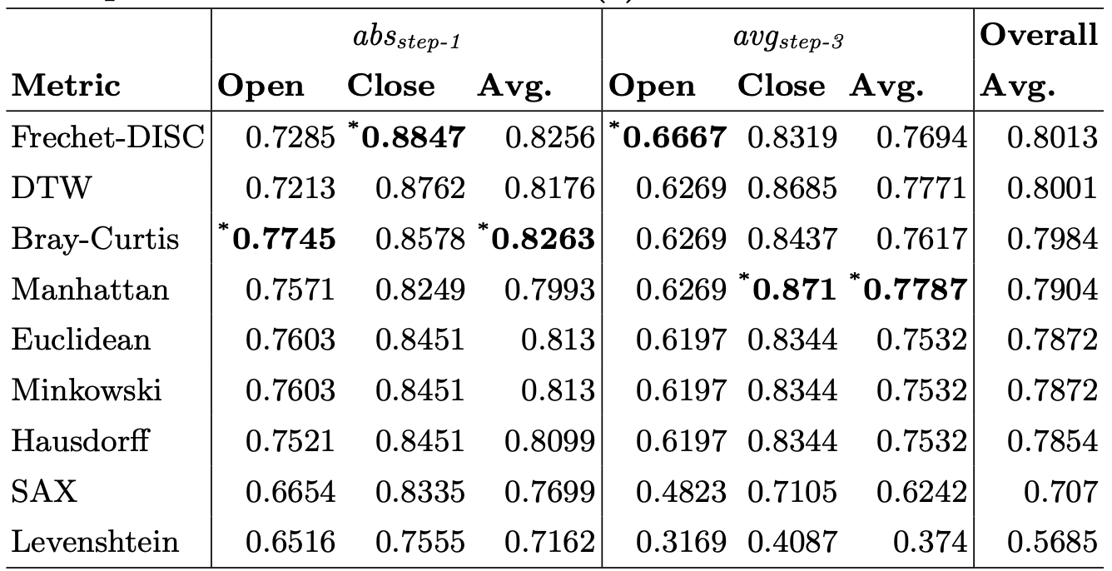
Overall, the best-performing metric using Micro-averaging of the F1 score
There are:
115 and 189 open and close events, respectively, for abs step-1
77 and 154 open and close events, respectively, for average step-3.
These instances report those valves where at least a strange behaviour was observed. The top-ranked ones in each column are represented in bold with the (*).
Based on the average scores Frechet-DISC performs the overall best, with DTW close behind. Bray-Curtis is at least 77 times faster compared to Frechet-DISC and DTW.

Slide 22
Conclusion and future work
We presented predictive maintenance models for the identification of developing issues in the subsea valve.
We discussed supervised AdaBoost, which was discovered to be the best-performing model, but RF is ten times faster.
We used a criterion to justify the trade-off and reported 0.961 accuracy, with as little as 20 FN and yet a high value of 5991 TN.
Frechet and dynamic time warping were the best-performing distance metrics for anomaly detection, and Bray-Curtis underperformed by a small fraction of 0.03 F1-score but performed 77 times faster.
We are using three classes in supervised learning.

Slide 23
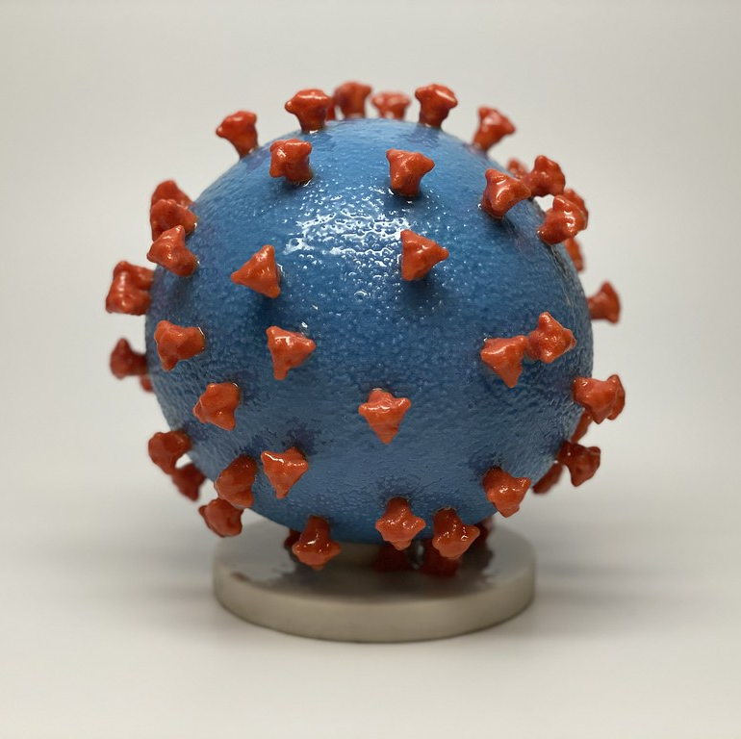
Machine learning applied to Covid-19 prevention
Dr Luis Miralles-Pechuán

Slide 24
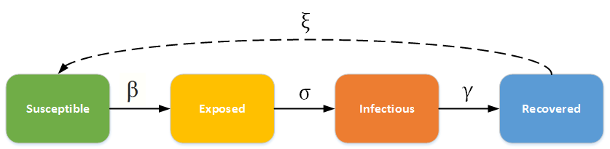
SEIR epidemiological model for COVID-19
The SEIR model divided the population into three categories:
Susceptible represents healthy individuals.
Exposed represents the individuals who contracted the disease but do not transmit it.
Infectious individuals are the ones who transmit the disease.
Recovered individuals have recovered from the disease or have died from it.

Slide 25
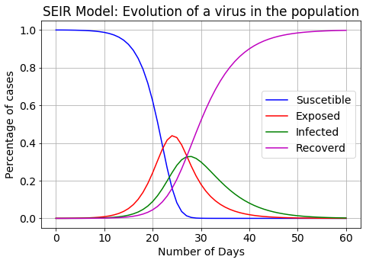




Modelling the Covid-19 simulation
• 𝛼 is the inverse of the average incubation period in days.
• 𝛽 or contact rate represents the average number of people an individual is in touch with and therefore can potentially transmit the disease.
• 𝛾 is the inverse of the average period in days in which an individual is infectious.

Slide 26
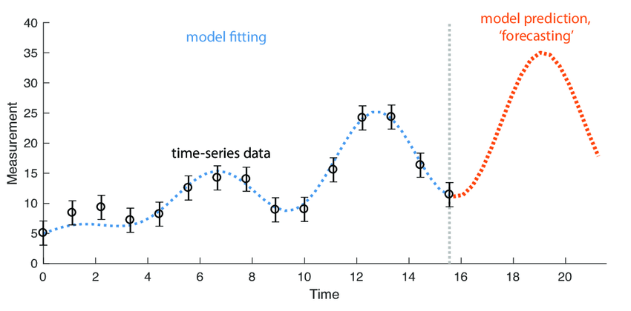
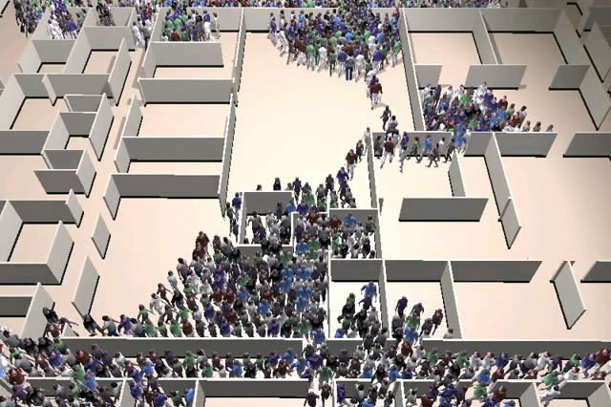
Time series and multi-agent models
http://gamma.cs.unc.edu/CA/
https://www.researchgate.net/publication/320032800_Feature-based_time-series_analysis

Slide 27
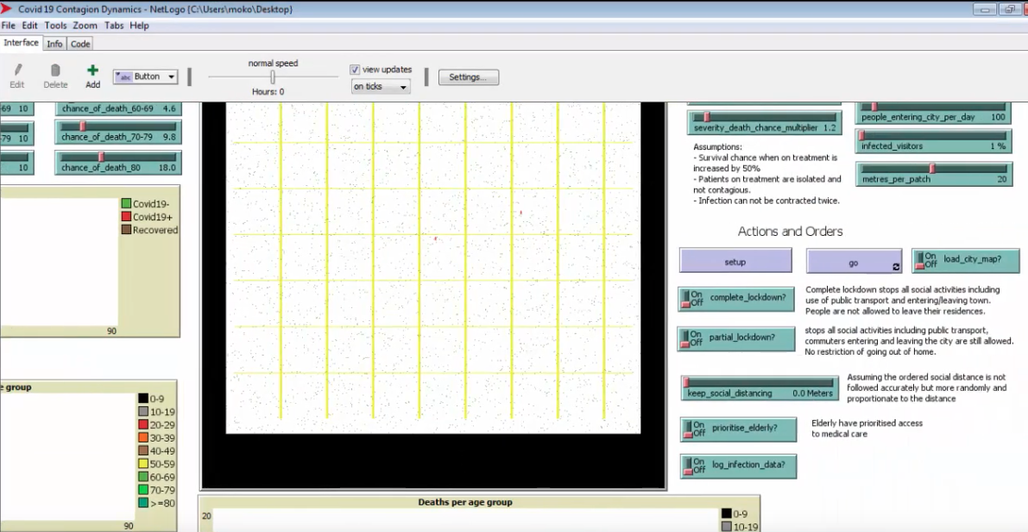
Video about Covid-19 simulation
https://www.youtube.com/watch?v=VaGFCEi46Fk&ab_channel=StatPharm

Slide 28
Time series and multi-agent models
https://www.researchgate.net/publication/320032800_Feature-based_time-series_analysis

Slide 29
Predicting Covid-19 using incremental methods

Slide 30
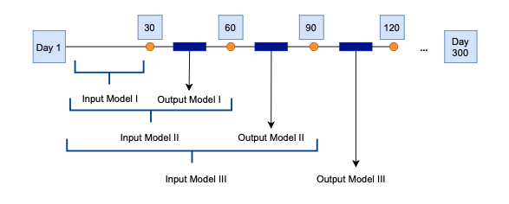
How do we use predictions?

Slide 31
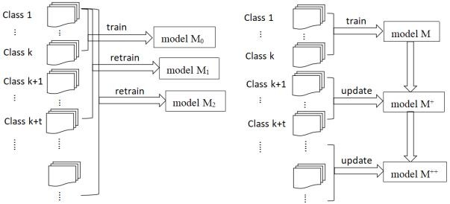
Using incremental ML methods
https://www.linkedin.com/pulse/incremental-learning-live-machine-model-training-approach-patel/

Slide 32
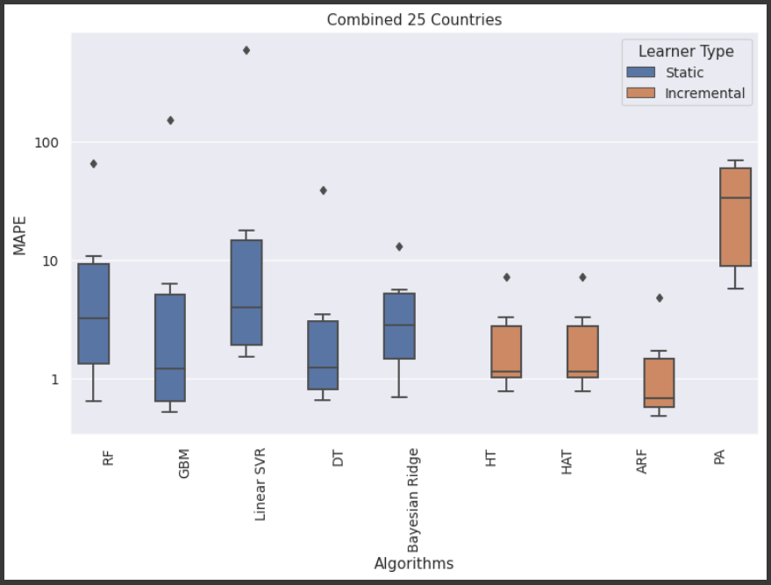

Slide 33
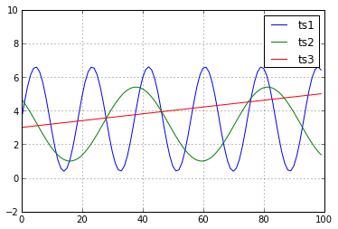
Euclidean distance is not the best similarity measure
Euclidean distance between ts1 and ts3 is smaller than ED between ts2 and ts3.
Euclidean distance is not always the best measure

Slide 34
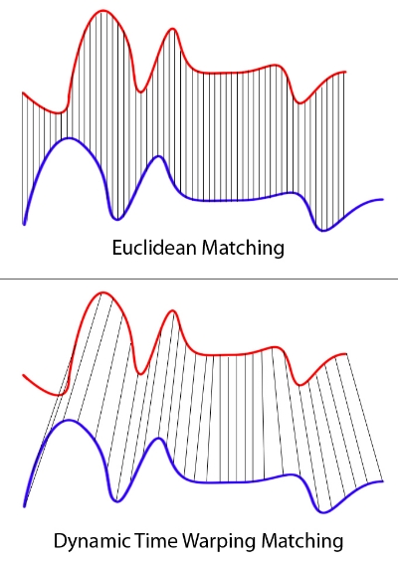
Dynamic Time Warping
Dynamic time warping (DTW) is a well-known technique to find an optimal alignment between two given (time-dependent) sequences under certain restrictions
Sakoe, Hiroaki, and Seibi Chiba. "Dynamic programming algorithm optimization for spoken word recognition." IEEE transactions on acoustics, speech, and signal processing 26.1 (1978): 43-49. (5000 citations)
https://www.youtube.com/watch?v=_K1OsqCicBY

Slide 35
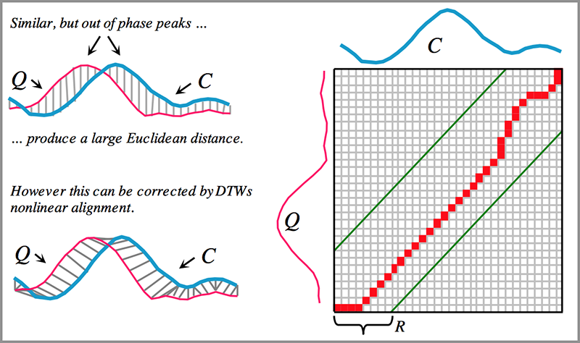
What is DTW versus Euclidean Distance?

Slide 36
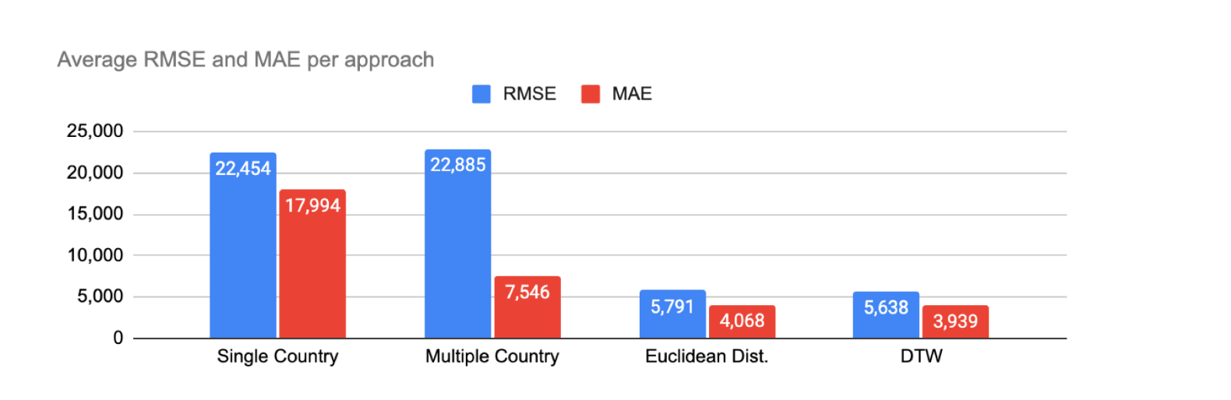
Euclidian distance and DTW

